Slide 1
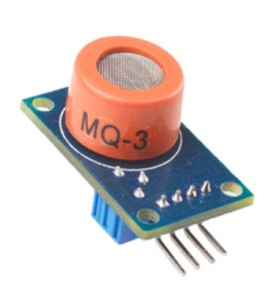

DEPARTMENT OF ELECTRONICS AND COMMUNICATION ENGINEERING
PROJECT
PANDEMIC-PREVENTING SYSTEM BASED ON
MQ-3 SENSOR
GUIDED BY,
PRABAGARAN D, M.E
PROJECT BY,
P. HARIKARAN
M. VIJAY
M. SRIDHAR M
A. KIRUBHANITHI

Slide 2
CONTENT
Abstract.
Viral pandemic.
Preventing methods.
Importance of hand sanitizer.
The carelessness of people.
MQ3 sensor.
How we use MQ3 sensor?
What is Servo Motor.
How we use Servo?
What is RFID?
How we use RFID?
Circuit diagram.
Future scope.
Conclusion.

Slide 3
ABSTRACT
During the pandemic situation, human hands are one of the primary transmission media for viruses.
To avoid this virus transmission, we introduce two concepts: an RFID attendance-making system interfaced with the MQ3 sensor and an automatic door-opening system interfaced with the MQ3 sensor.
This system makes hand sanitation mandatory.

Slide 4
VIRAL PANDEMIC
A pandemic is the worldwide spread of a new disease.
Viral respiratory diseases, such as those caused by a new influenza virus or the coronavirus COVID-19, are the most likely to turn into a pandemic.

Slide 5
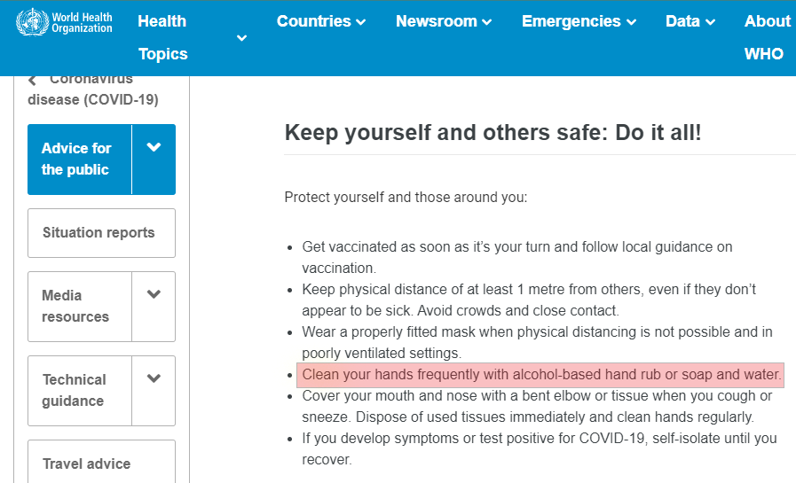
PREVENTING METHODS
PREVENTING METHODS

Slide 6
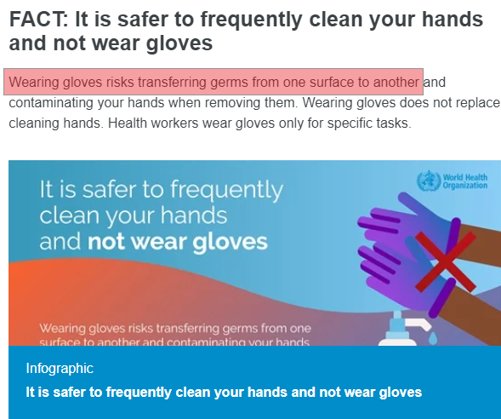
IMPORTANCE OF HAND SANITIZER
IMPORTANCE OF HAND
SANITIZER

Slide 7

THE CARELESSNESS OF PEOPLE
THE CARELESSNESS OF
PEOPLE
Some time people forgot to sanitize their hands.
Some people avoid hand sanitizer by their carelessness.
It helps in transmission of virus from one person to another person.

Slide 8
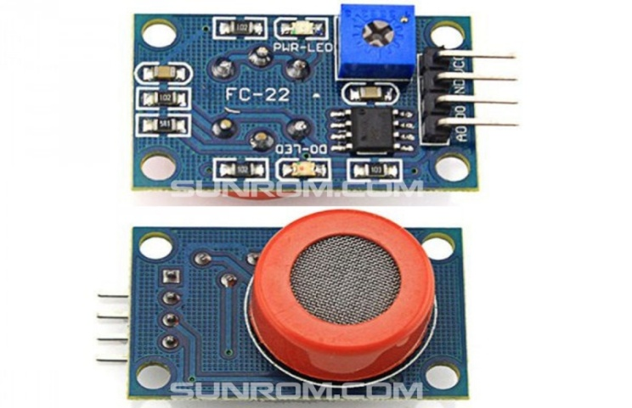
WHAT IS MQ3 SENSOR
MQ3 SENSOR
It is a low cost semiconductor sensor which
can detect the presence of alcohol gas.
The sensitive material used for this sensor is SnO2, whose conductivity is lower in clean air.
It’s conductivity increases as the concentration of alcohol gases increases.

Slide 9
HOW WE USE MQ3 SENSOR
HOW WE USE MQ3 SENSOR
The MQ3 sensor is capable to detect ethanol that in gas form.
Hand sanitizers contain 60% to 80% of ethanol in it.
In this Project we use MQ3 sensor to detect the hand sanitizer.
By detecting hand sanitizer, we can build lots of protection methods by using electronics.
In this project we can build sanitizer based attendance making system by using RFID interface with MQ3 sensor and automatic door opening system using servo motor interface with MQ3 sensor.

Slide 10
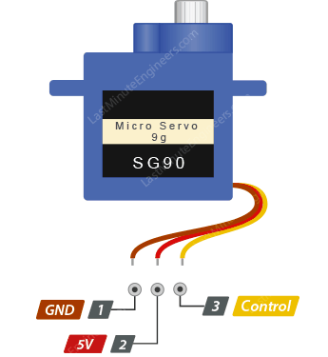
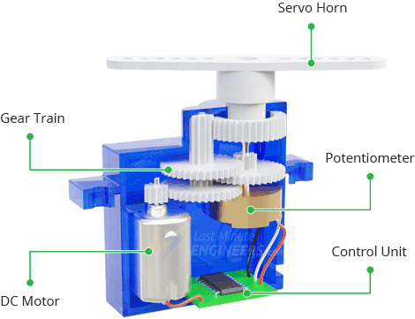
WHAT IS SERVO MOTOR
WHAT IS SERVO MOTOR?
Servos are motors that allow you to precisely control physical movement because they generally move to a position rather than continuously rotating.
The potentiometer provides position feedback to the error amplifier in the control unit, which compares the current position of the motor to the target position.

Slide 11
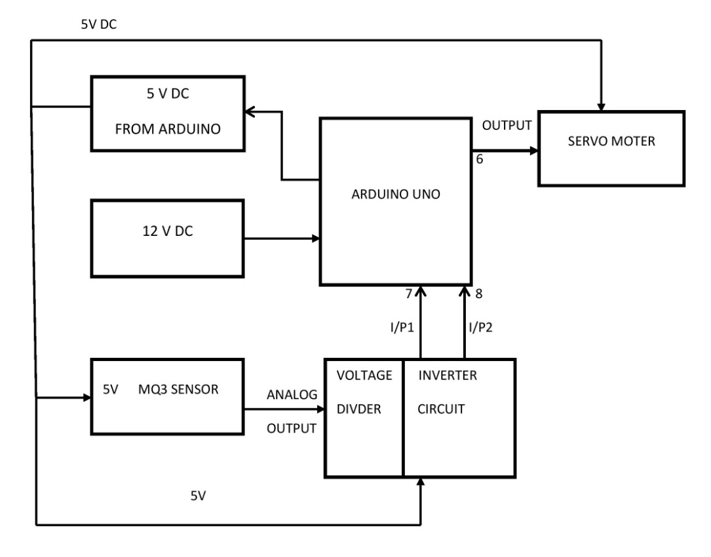
HOW WE USE SERVO

Slide 12
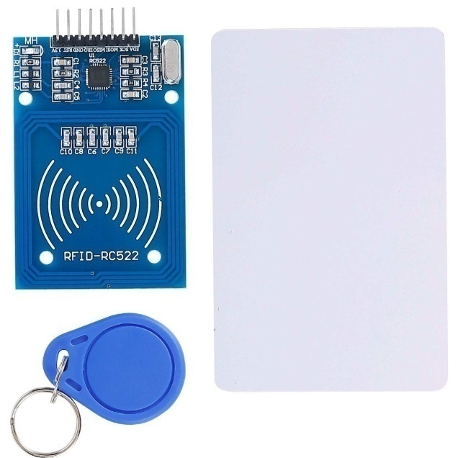
BASICS OF RFID
Radio Frequency Identification (RFID) refers to a wireless system comprised of two components: tags and readers.
The reader is a device that has one or more antennas that emit radio waves and receive signals back from the RFID tag.
By reading the UID of a card or
tag, we can find the data
stored about the UID (Name,
mail id, mobile number, etc)

Slide 13
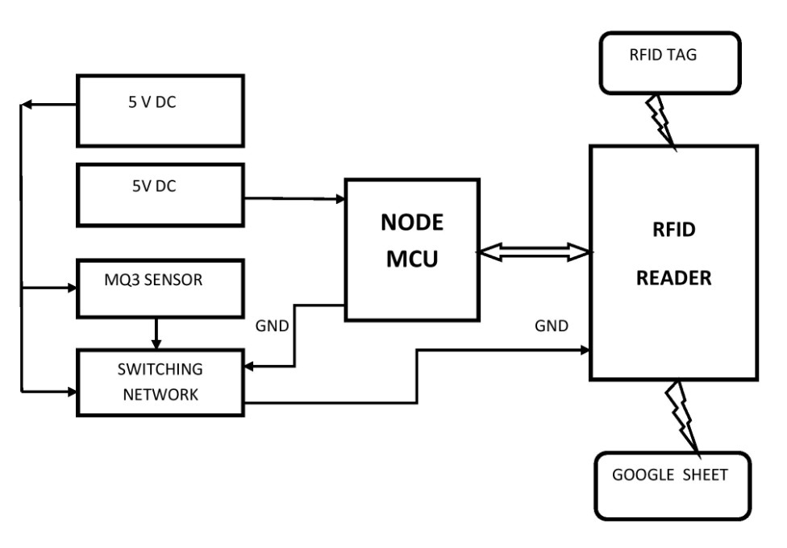
HOW WE USE RFID

Slide 14
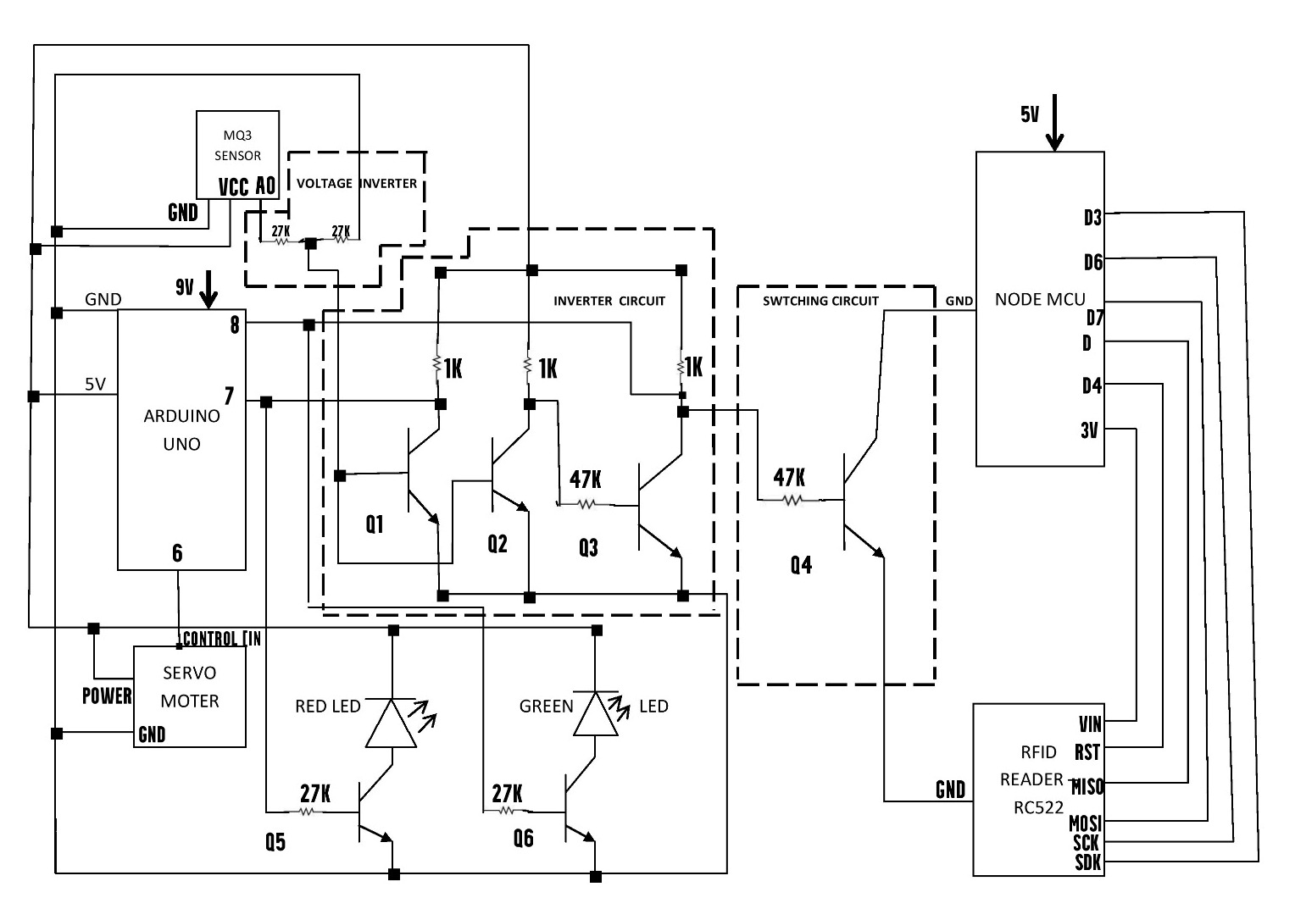
CIRCUIT DIAGRAM

Slide 15
CONCLUSION
By Using these devices we can reduce the transmission of viruses through hands.
The MQ3 sensor, servo motor, RFID, Arduino UNO and Node MCU are very low cost electronic devices, So the small shops also can afford these products easily.
These products can contribute to reducing the transmission of viruses during pandemic situations.

Slide 16
FUTURE SCOPE
In the future, these devices are become more demandable by companies, Malls, and small shops.
In the future, we can easily add many features with these devices like interfacing mask detection with the MQ3 sensor and RFID to make a mask and hand sanitation mandatory for all.

Slide 17



THANK YOU!

